Slide 1

EDA TMDB 5000 Dataset
Muthukumar Kadhirvel

Slide 2
Contents
Dataset & Variables
Histogram
Descriptive Characteristics
Compare using PMF
CDF & Analytical Distribution
Scatter Plots
Hypothesis Test & Regression Analysis
Conclusion & References

Slide 3
Dataset & Variables
We are using the TMDB 5000 Movie Dataset from Kaggle and this has various data about top 5000 movies.
https://www.kaggle.com/datasets/tmdb/tmdb-movie-metadata?select=tmdb_5000_movies.csv
The variables we are using in our analysis are as below:
Title – Text - Title of the movie
Language – Text - Language of the movie
Release Date – Date in MM/DD/CCYY format - Release date of the movie
Budget – Integer – Budget in USD of the movie
Revenue – Integer – Revenue in USD of the movie
Runtime – Integer – Total time in minutes of the movie
Popularity – Integer – Popularity Index of the movie
Rating – Integer – Rating of the movie out of 10
Vote Count – Integer – Number of votes for the movie

Slide 4
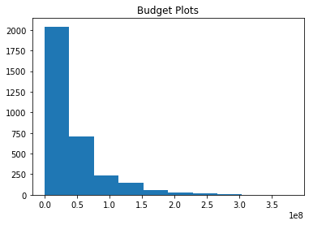
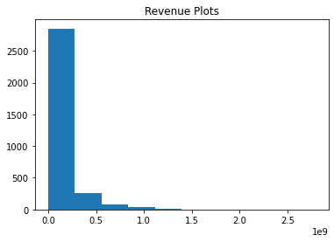
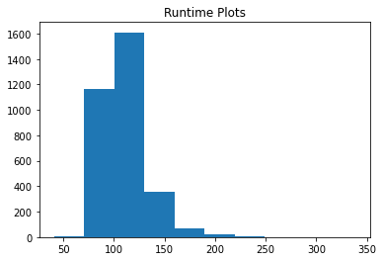
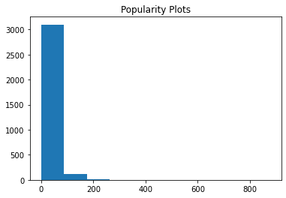
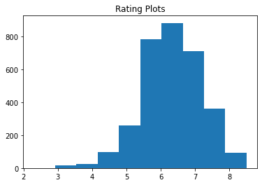
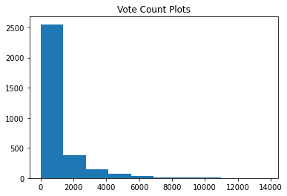
Histogram
Although there are outliers in all the variables there were none that we could discard.
For example, we can see few movies have huge budget compared to the majority, but we cannot discard them as they are needed to help us in our analysis.
The other columns also have similar so-called outliers but something that we cannot discard.

Slide 5
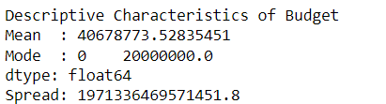
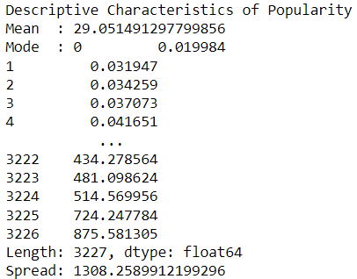
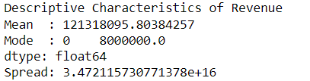
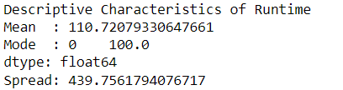
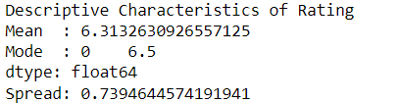
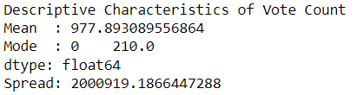
Descriptive Characteristics
Budget – Left Leaning Tail
Revenue – Left Leaning Tail
Runtime – Left Leaning Tail
Popularity – Left Leaning Tail
Rating – Right Leaning Tail
Vote Count – Left Leaning Tail

Slide 6
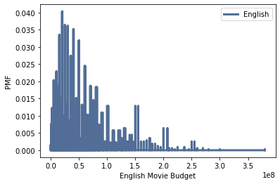
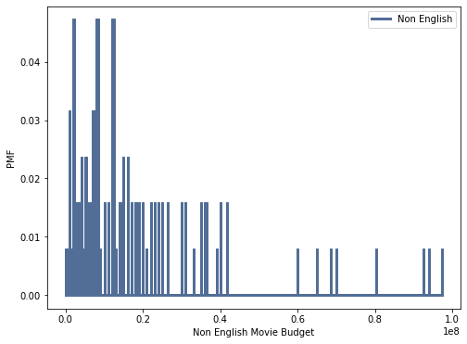
Compare using PMF
We are comparing English movies budget against Non-English movies budget using PMF
We are plotting the PMF of English movies and the Non-English movies
We can see that English movies have a budget that is higher than Non-English movies

Slide 7
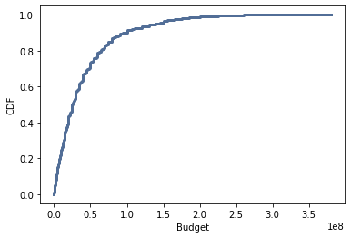
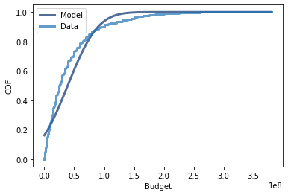
CDF & Analytical Distribution
We are creating a CDF of Budget variable and we plot them against the Budget variable
We can see that 90% of the movies have a budget less than 100,000,000
We then create a model and plot the analytical distribution against the model and data
The model is very close to the data

Slide 8
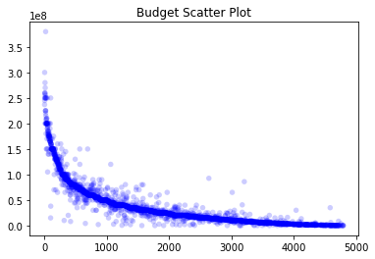
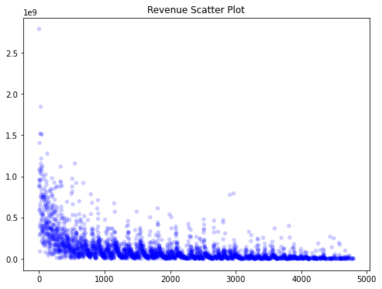
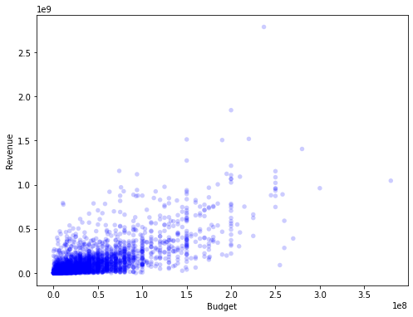
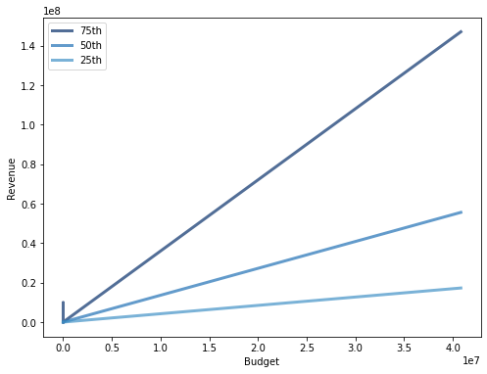
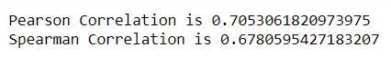
Scatter Plots
We create individual scatter plots for Budget and Revenue and as we can that there are a very few outliers for Budget but for Revenue there are many outliers
Then we create a scatter plot of Budget against Revenue and as we can see they are very close and there are very few outliers
Then we create a Percentile plot, and we can clearly see that Budget and Revenue have a very linear relationship without any extremes
We have a positive correlation as per the plots and the below values. Since we have outliers, the Pearson Correlation is higher than Spearman Correlation which is more robust to outliers

Slide 9
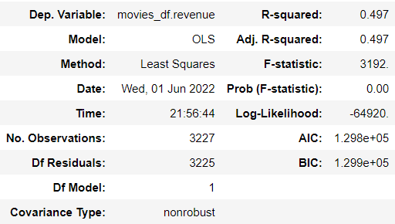
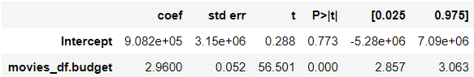
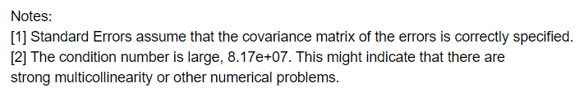
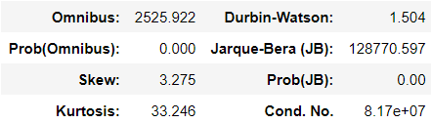
Hypothesis Test & Regression Analysis
We conduct the Permutation Hypothesis Test and compute the P-Value of an observed difference in means and we assume no difference between the groups and generate results by shuffling the data
We get a value of 0.001 which is very close to 0 which indicates that our null hypothesis is rejected, and our test is statistically significant.
For Regression Analysis we perform against Budget and Revenue
We get a high condition number and that indicates a strong multicollinearity and a high degree of correlation between Budget and Revenue

Slide 10
Conclusion & References
We tried to find the relationship between budget and revenue of the top five thousand movies
Based on EDA we can see there is a high correlation between budget and revenue.
Using the PMF we can see that budget for English movies are higher than Non-English movies
Using the CDF, we can see 90% of the movies have a budget of less than one hundred million.
Scatter Plots shows us a clear relationship between Budget and revenue which is also confirmed by the Percentile Plots.
Regression Analysis also shows a high degree of correlation between Budget and Revenue
https://www.kaggle.com/datasets/tmdb/tmdb-movie-metadata?select=tmdb_5000_movies.csv

